Slide 1
Psychometric Network construction, community detection and node embedding
An analysis of two datasets of a 200-item personality questionnaire
Tomáš Vojtíšek
25.5.2024
University of Tartu
https://github.com/tomvojtisek/Network-Science-Project

Slide 2
Problem statement
Personality measurement is a continuously growing area of research
Currently, the space is dominated by the big-5 theory which was obtained inductively using factor analysis.
While this theory has many problems, it is bound strongly to the measurement of personality due to absence of other analytic methods.

Slide 3
Motivation
Network analysis is a promising alternative model for understanding relationships between questionnaire responses and understanding the structure of human personality.
It has already been used in other areas (modelling symptoms of psychopathology, structure of intelligence, and others)
The use of network analysis for psychological constructs is mostly limited to analysing the descriptives of the network strucutre
Can we use more advanced techniques to meaningfully analyse psychometric networks?

Slide 4
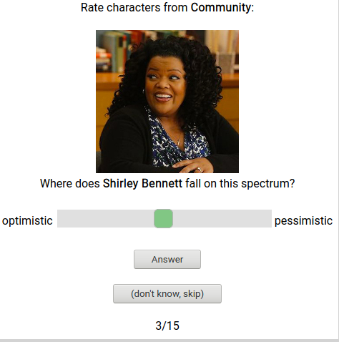
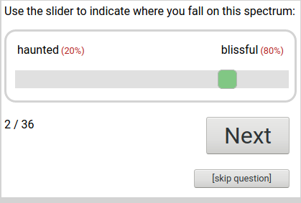
Dataset
Answers on bipolar adjective pairs
Two datasets:
Self-report
Fictional character rating

Slide 5
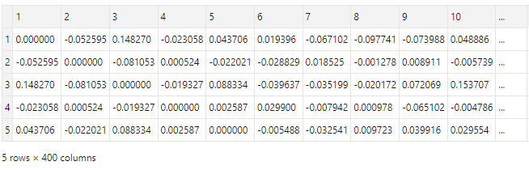
Psychometric network estimation
Modelling relationships between the 400 items (adjective pairs) on the questionnaire.
Nodes: test items
Edges: correlations between answers
2 networks:
real self-report (n= 3mil)
Fictional characters

Slide 6
Methodology
Data-generation: pearson correlation matrix with 0.1 correlation threshold
Descriptives: degree, density, transitivity, clustering
Community membership detection: Walktrap and fast community unfolding
Node embedding and similarity rating comparison: Node2Vec, similarity for all pairs, correlation between the two networks.

Slide 7
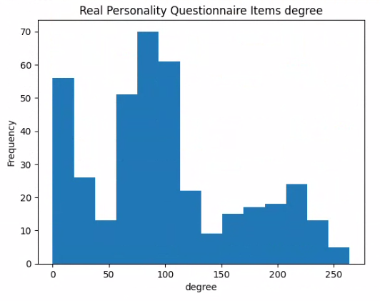
Real personality item network
400 nodes
0.25 density
0.47 transitivity

Slide 8
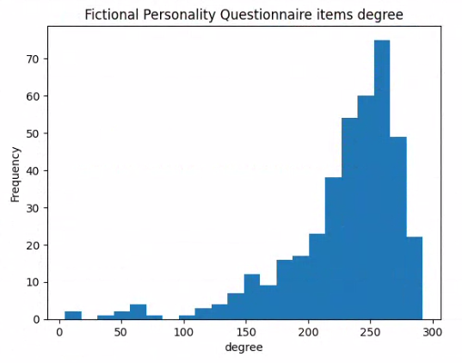
Fictional characters personality network
400 nodes
0.57 density
0.65 transitivity

Slide 9
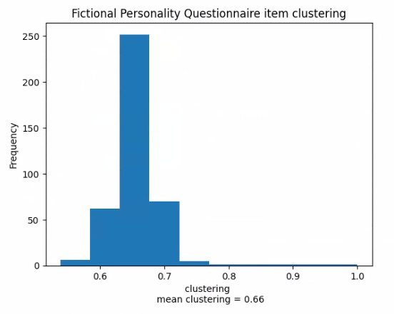
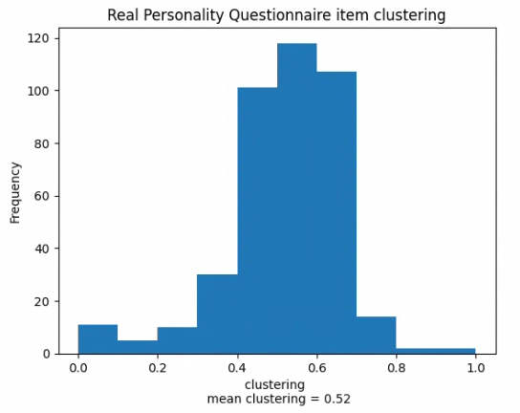
Clustering

Slide 10
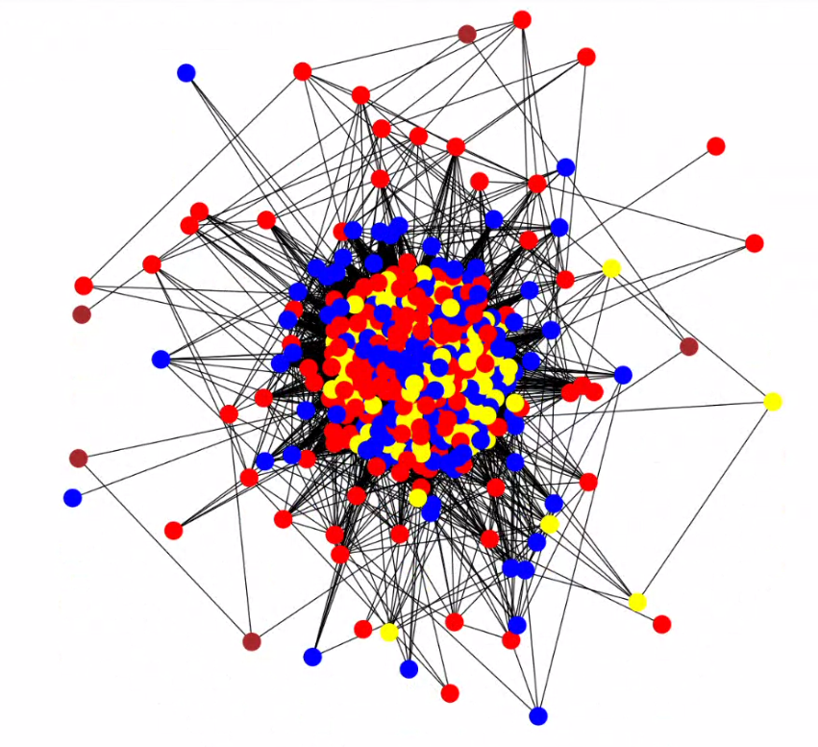
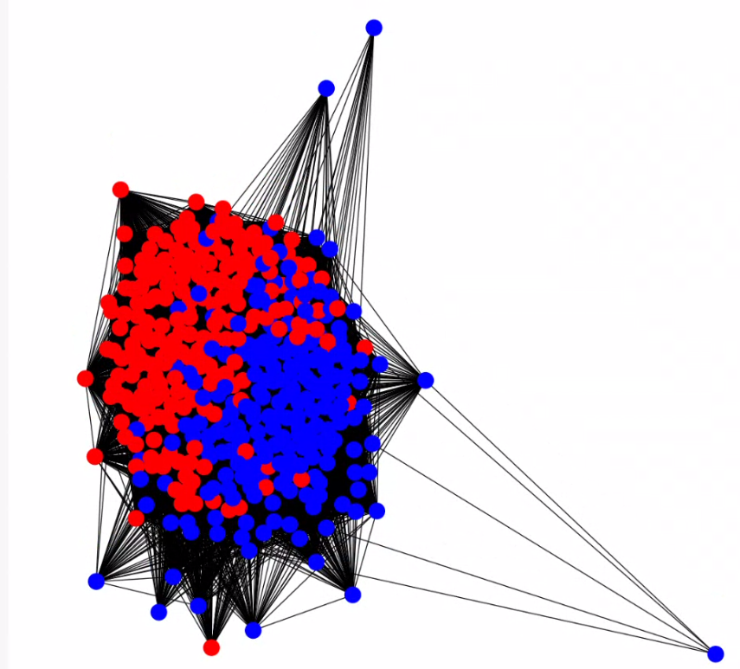
Community detection

Slide 11
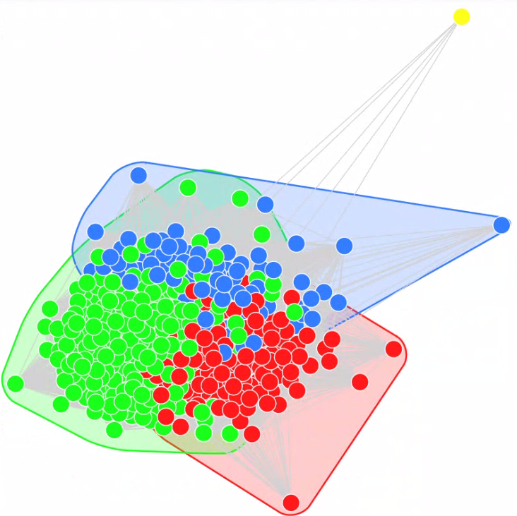
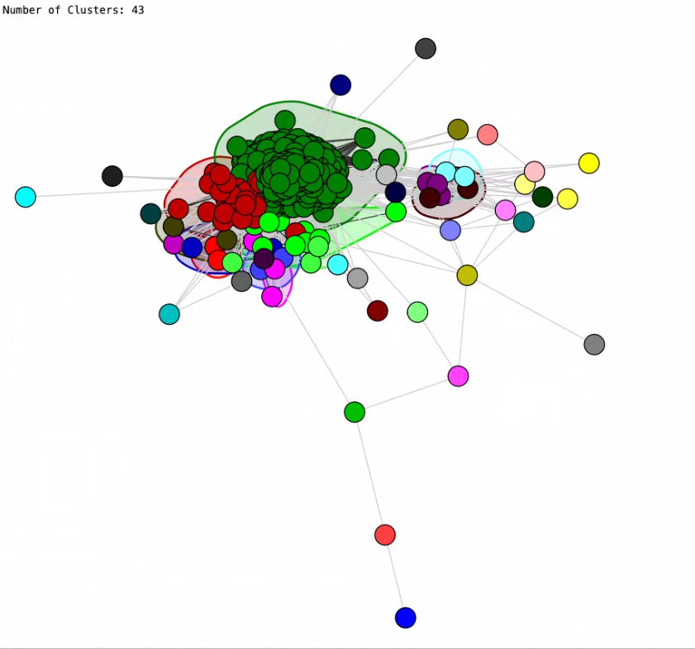
Walktrap

Slide 12
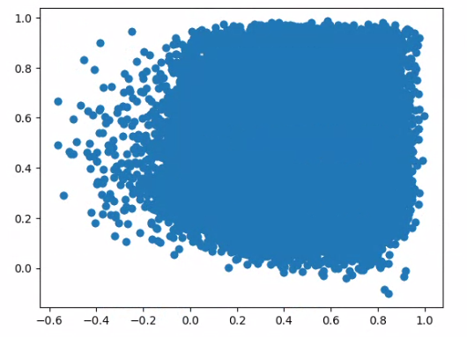
Node2Vec embedding similarity r = 0.021

Slide 13
Conclusions
Self-report real personality responses are of a distinctly different structure than 2nd person ratings of fictional characters
Self-report is relatively less dense and less tightly connected: answers on the personality questions (nodes) are less strongly connected than for fictional characters.
Finally, node2vec embeddings similarity estimations show very small correlation (although statistically significant p < 0.001) corroborating the difference of structure of the two networks despite the substantive similarity of the data-generating process.

Slide 14
Meaningfulness of the communities?
Fictional
Community 1:['shy', 'bold']['cheery', 'sorrowful']['charming', 'awkward']['trusting', 'suspicious']['innocent', 'worldly']['cunning', 'honorable']['competitive', 'cooperative‘]…
Community 2:['playful', 'serious']['masculine', 'feminine']['lewd', 'tasteful']['intellectual', 'physical']['strict', 'lenient']['refined', 'rugged']['artistic', 'scientific‘]…
Real:
Community 1:['shy', 'bold']['charming', 'awkward']['lewd', 'tasteful']['strict', 'lenient']['innocent', 'worldly']['cunning', 'honorable']['orderly', 'chaotic']['competitive', 'cooperative']['brave', 'careful']['ferocious', 'pacifist‘] …
Community 2:['playful', 'serious']['cheery', 'sorrowful']['intellectual', 'physical']['refined', 'rugged'] ['trusting', 'suspicious']['stoic', 'expressive']['normal', 'weird‘]…
Community 3:['legit', 'scrub']['German', 'English']['Italian', 'Swedish']['unlucky', 'fortunate']['diligent', 'lazy‘] …
Community 4:['arcane', 'mainstream']['spiritual', 'skeptical']['masculine', 'feminine']['artistic', 'scientific']['creative', 'conventional‘]
Requires work

